Slide 1

How to Retrieve data from SQL server using Web API and Entity Framework.
Peeyush Kaul
Photo by Arnold Francisca on Unsplash

Slide 2


Contents
Here, We are using Visual Studio 2017 and SQL Server Management Studio(SSMS).
These are the steps we need to follow:
Create a Blank Web API project
Select Web API in the template selection window
Add an ADO.NET Entity Data Model
Create a new connection with SQL server
Generate entities from Database
Add a Controller
- Return all the data
- Return specific data by ID
Run the Project
MediaTypeFormatter
- Return only JSON from ASP.NET Web API Service
- Return only XML from ASP.NET Web API Service

Slide 3
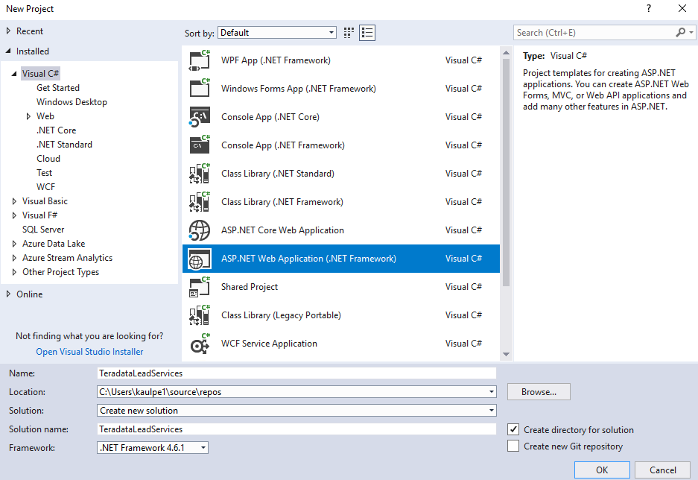
Create a Blank Web API Project
To begin with, Run Visual Studio
Please follow the below steps to create a new project :
File → New → Project and select ASP.NET Web Application (.NET Framework)
Name the project as
“TeradataLeadServices“and then click OK.

Slide 4
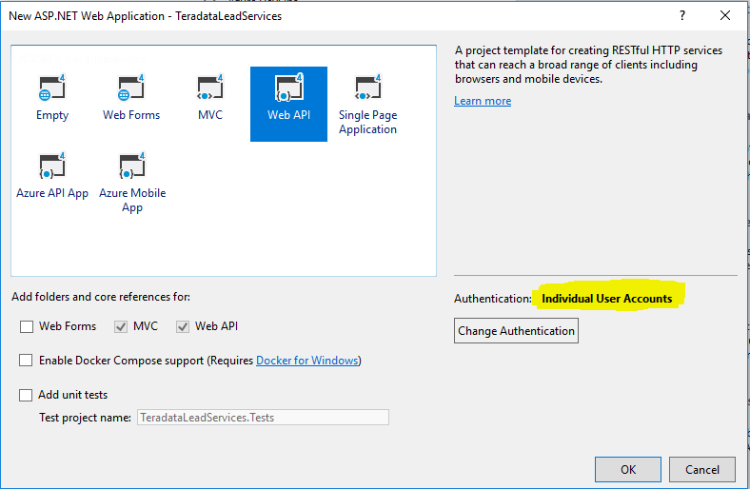
Select Web API in the template selection window
Please select Web API in the template selection window.
Make sure the Authentication is set to Individual User Accounts.
And then click on OK
…
As you can see, we have successfully
created our new empty Web API project.

Slide 5
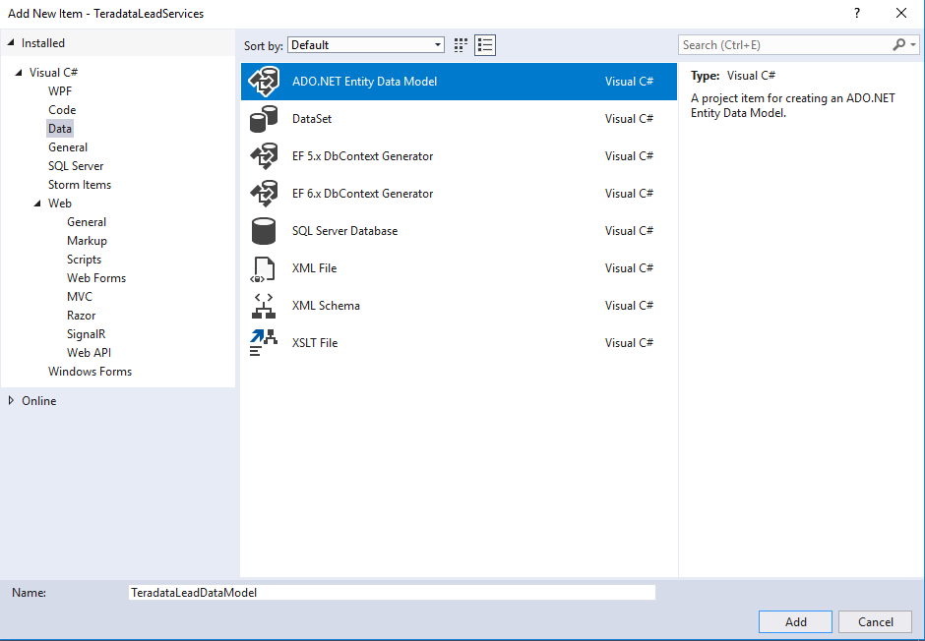
Add an ADO.NET Entity Data Model
Now, Let’s add and create a web service that will contain ADO.NET Entity Data Model that retrieves
the data from the SSMS.
Please follow the below steps :
right-click on TeradataLeadServices (Project)→ Add → New Item.
Then, select “Data” from the left pane.
Select ADO.NET Entity Data Model from the
right pane.
Name it as TeradataLeadModel and click Add.

Slide 6
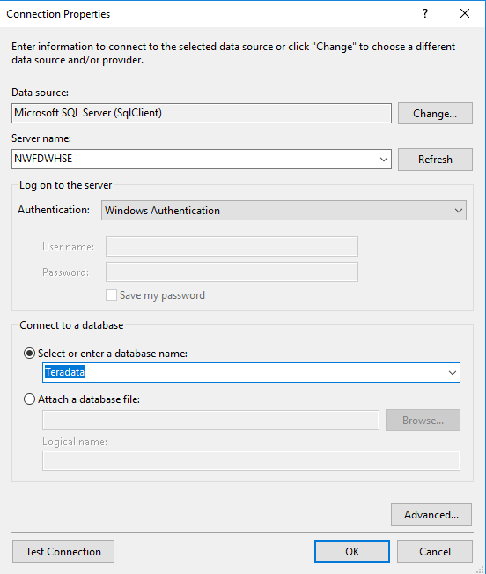
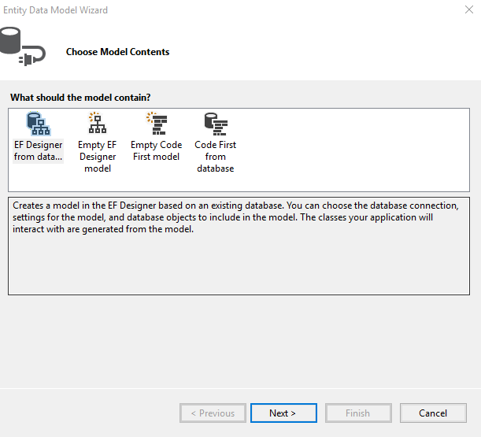
Create a new connection with SQL Server
On the next screen, we are going to select “EF Designer from database”and then click on Next>
Click on “New Connection” and select the “Microsoft SQL Server” as your data source. Then select/
enter the server name and the database.
Test Connection and click on OK

Slide 7
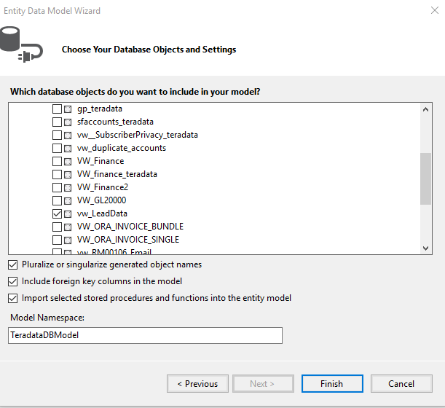
Generate entities from Database
On the next screen, select “vw_LeadData" view and click Finish.
*You can also select a Table here. In our case, we are selecting a View.

Slide 8
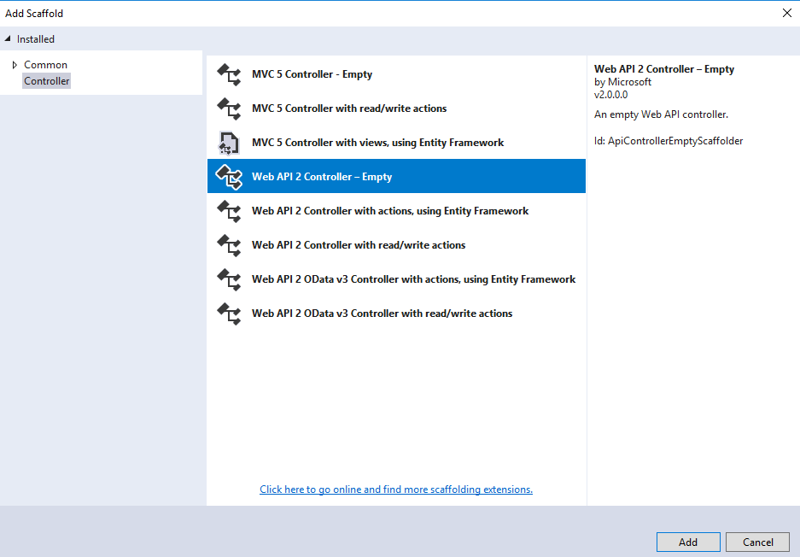
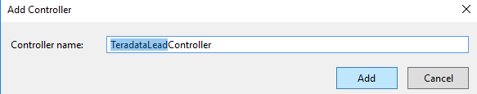
Add a Controller
Please follow the below steps to add a controller:
Right click on the Controllers folder in TeradataLeadServices project and select Add – Controller
Select "Web API 2 Controller - Empty" and click Add
On the next screen set the Controller Name
as TeradataLeadController and click Add

Slide 9
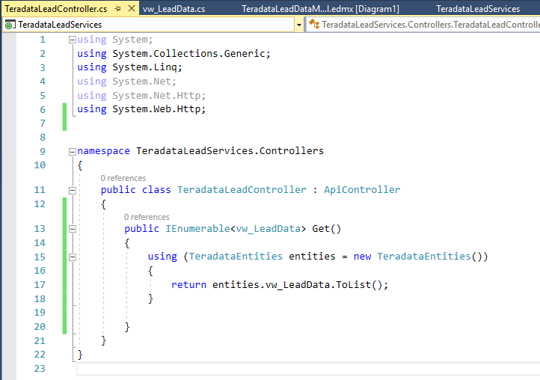
Add a Controller : Return all the data
Now, Let’s write a GET Method in our controller which will respond to the HTTP GET Verb.
Return all the data ( Return all the Lead data)
…
Now let’s try to build and run our project
When you navigate to /api/TeradataLead you
should see all leads.

Slide 10
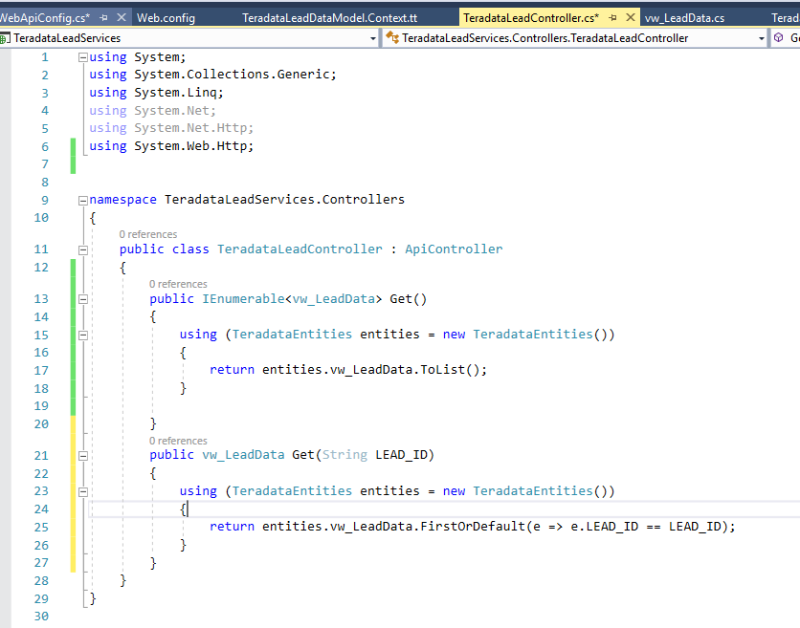
Add a Controller : Return specific data by ID
Return a specific data by ID
(in our case: LEAD_ID)
Let’s add this line to the controller class.
I have used the lambda expression herein
each LEAD ID.

Slide 11
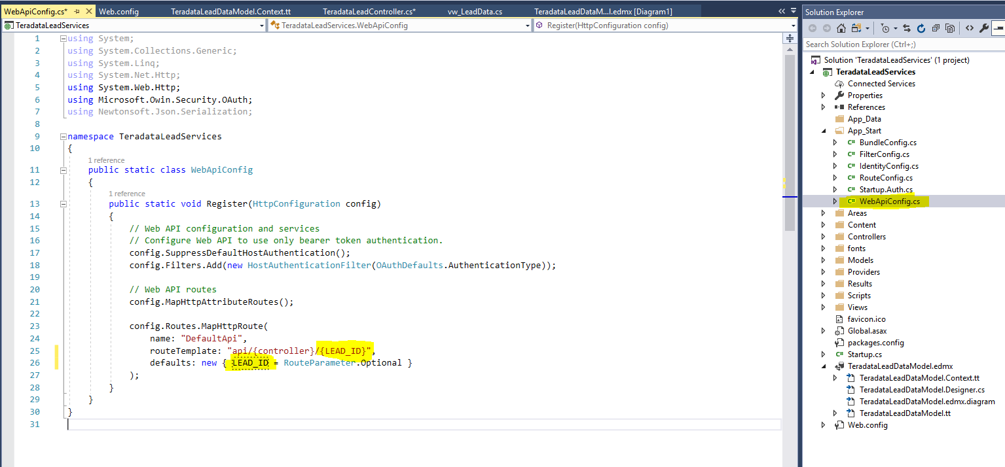
Also please make sure to change ID to LEAD_ID in WebApiConfig.cs. This will return a specific lead by ID.
Now let’s try to build and run our project

Slide 12
Media Type Formatter
Media type formatters are classes accountable for serializing request/response data so that Web API can
understand the request data format and send data in the format which client expects.
JsonMediaTypeFormatter handles JSON and XmlMediaTypeFormatter handles XML.
To return only JSON from ASP.NET Web API Service irrespective of the accept header value:
Include the following line in Register() method of WebApiConfig.cs file in App_Start folder .Use this
technique when you want your service to support only JSON and not XML.
config.Formatters.Remove(config.Formatters.XmlFormatter);
To return only XML from ASP.NET Web API Service irrespective of the accept header value:
Use this technique when you want your service to support only XML and not JSON.
config.Formatters.Remove(config.Formatters.JsonFormatter);

Slide 13
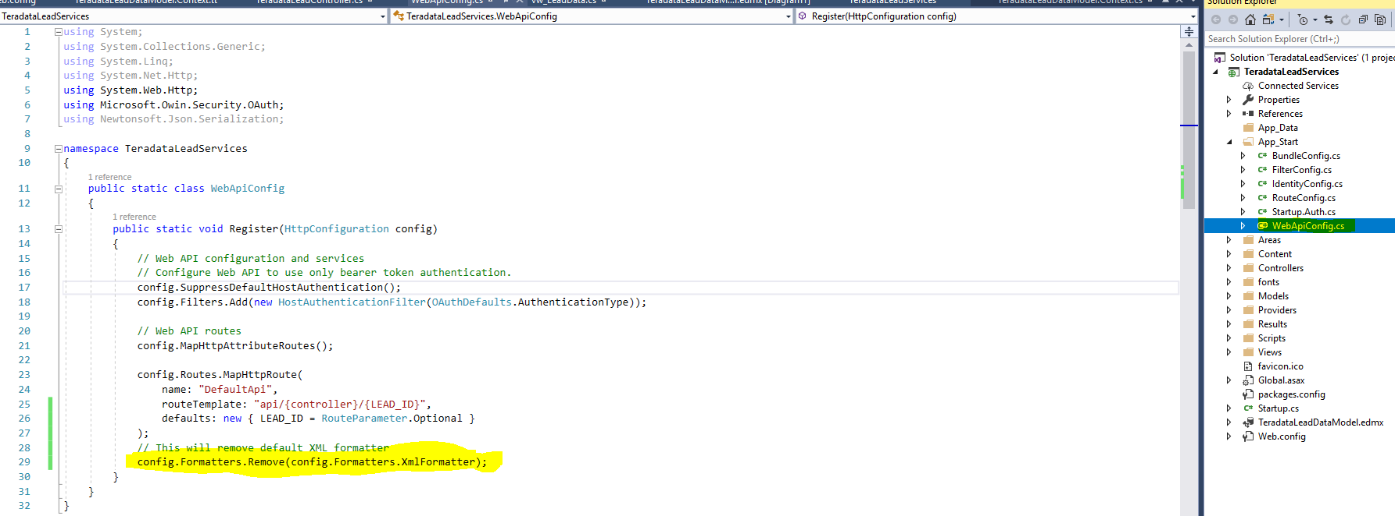
Including the following line in Register() method of WebApiConfig.cs file in App_Start folder .Use this technique when you want your service to support only JSON and not XML. Now try to build and run the project.

Slide 14
Thank You.

